Slide 1
Airlines and Aircraft Noise Management & Reduction
November 15, 2017
N.O.I.S.E. Policy Summit and Community Involvement Workshop
Nancy Young, Vice President, Environmental Affairs
Airlines for America (A4A)
Notes:
1

Slide 2
Overview
Tremendous Aircraft Noise Reductions
But Changed Exposures from New/Revised ATC Procedures Have Caused Concerns
How Those Concerns Are Being Addressed
A Word About the U.S. Airlines’ Synergistic Environmental Commitments
2

Slide 3
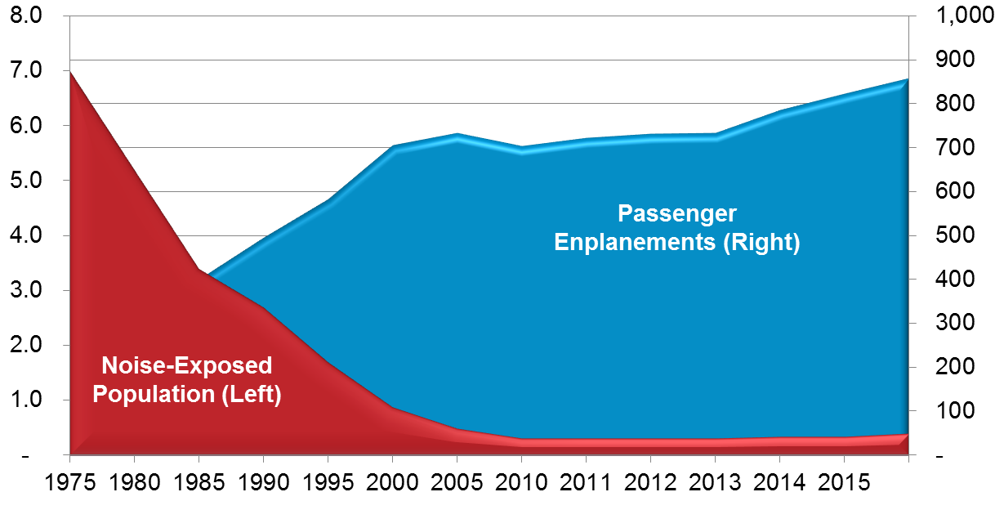
U.S. AVIATION’S STRONG NOISE REDUCTION RECORD
From 1975-2016, the Number of U.S. Residents Exposed to Significant Aircraft Noise Fell 94% While Enplanements Rose 325%); 53% from 2000-2016 (Enplanements Rose 22%)
Millions of People¹
Millions of Passengers²
U.S. residents exposed to “significant” (65 dB DNL) noise levels from all aviation operations within U.S. airspace
Passengers enplaned on U.S. and foreign flag carriers as captured in the FAA Terminal Area Forecast (TAF)
3

Slide 4
How Aviation Has Greatly Reduced Aircraft Noise
Through Investment, Technology and Operations
Aircraft Are 75% Quieter Today than the First Generation of Jet Aircraft
And today’s new aircraft are 50% quieter than aircraft 10 years ago
Stringent Aircraft Noise Standards and Noise Policy Requirements
Research & Development Programs
Airlines Use Operating Procedures to Reduce Noise – NextGen Can Help Enable This
4

Slide 5
NextGen Is Critically Important to the U.S.
But There Can Be Changes in Noise Exposure
NextGen Is Necessary & Highly Beneficial
Necessary to maintain and enhance safety
Critical to U.S. competitiveness
Reduces delays
Enables further fuel and emissions reductions (climate and local impacts)
Can and often does decrease net noise exposures
But, New Procedures Can Raise Noise Concerns
New ATC procedures can shift who is exposed – even if fewer people overall are exposed; and some PBN procedures can “focus” noise more tightly over certain areas
Rather than the past where former procedures were changed as needed site-by-site, NextGen is in multiple Metroplexes at once
But note, FAA data shows that the vast majority of procedure changes have been non-controversial
5

Slide 6
How Aviation Is Addressing Heightened Noise Concerns
With Improved Finances, U.S. Airlines Are Purchasing More Newer & Quieter Aircraft
The top-ten U.S. passenger airlines:
took delivery of 353 new aircraft in 2016;
projected delivery of an additional 337 by year-2017;
more than 1300 firm orders for new aircraft scheduled for delivery in the coming years
The New U.S./ICAO “Stage 5” Noise Standard Goes into Effect for New Aircraft Year-End 2017
7 decibels reduction from Stage 4; approximately 35% quieter
6

Slide 7
How Aviation Is Addressing Heightened Noise Concerns (cont.)
Public-Private CLEEN R&D Program with FAA for Additional Noise Reduction at Source
Goal is aircraft achieving a 32 decibel reduction relative to the current standard
Implementing Continuous Descent & Other Noise-Reducing Operating Procedures Where Safe and Practicable
ATC procedures are highly technical and safety is paramount; and “local” procedures must work within National Air Space
Supporting Community Outreach/Engagement
7

Slide 8
Aviation Support for Enhanced Community Outreach
Airlines, Airports, N.O.I.S.E & FAA Engagement
2014 and 2016 NextGen Advisory Committee (NAC)/Industry PBN Blueprint Recommendations
Comprehensive recommendations for enhanced outreach
FAA Is Implementing
Updated the FAA Community Involvement Manual
Formed a Noise Complaint Initiative (NCI) working group
Enhanced Metroplex outreach strategy and supporting tools, scalable to single sites
8

Slide 9
A Word About the U.S. Airlines’ Synergistic Environmental Commitments
Strong Environmental Record . . .
94% reduction in significant noise exposures 1975 to 2016, while enplanements rose 325%
2% of man-made CO₂, while 5% of the GDP; and we have an aggressive climate commitment going forward
Carbon monoxide and smoke virtually eliminated, and oxides of nitrogen from aircraft continually reduced
Voluntary program for aircraft deicing (on top of regs)
Extensive recycling initiatives
And We Are Focused on Continuing and Improving on that Record . . .
Highly interrelated, and ATC modernization is critical
9

Slide 10
In Sum …
U.S. Aviation Has a Strong Record of Noise Reduction and Is Committed to Further Reductions
NextGen Is Critically Important to the United States
Replacement of 1940s era radar system is a necessary and critical infrastructure project – benefits in safety, to the U.S. economy, U.S,-competitiveness, airports, airlines, communities, emissions reduction and, yes, even noise abatement procedures
But We Know that Can Be “Cold Comfort” to those Who Experience Increases in Noise
We Are Working with FAA, Airports, N.O.I.S.E and Other Stakeholders to Help Address the Issues
10

